Slide 1
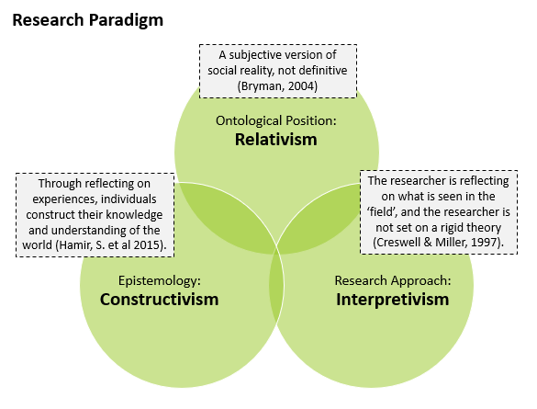
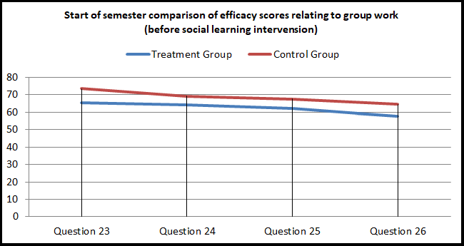
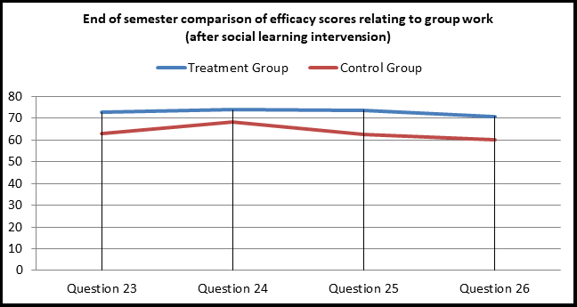
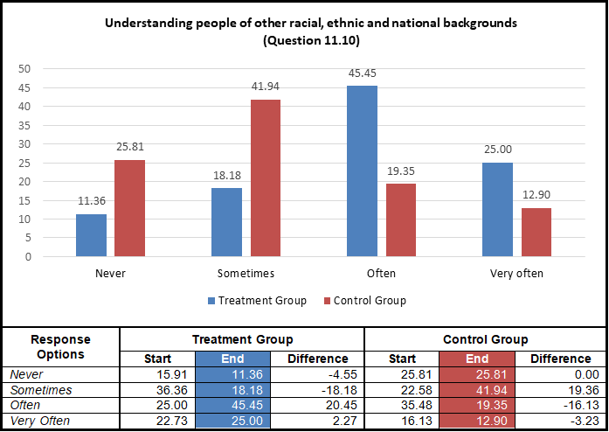
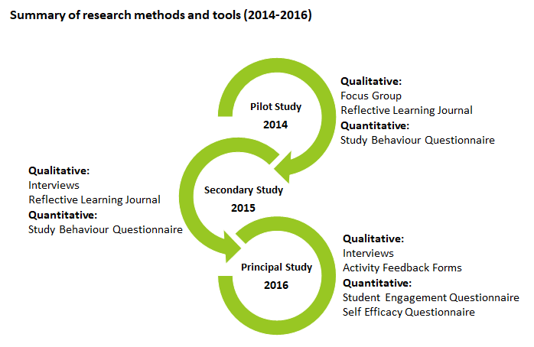
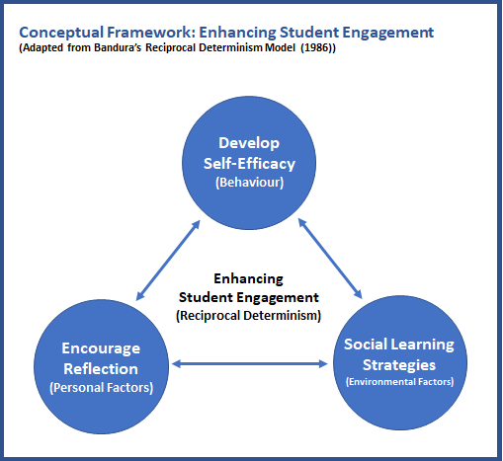
Cultivating Academic Self-Efficacy through supportive social and self-regulated learning strategies
for students in higher education
Graham Glanville, CCT College Dublin / University of Hertfordshire (EdD Cohort 9), May 2019
ABSTRACT
RESEARCH PARADIGM
FINDINGS
Self Efficacy
This research set out to enhance engagement in computer programming, a known difficult subject area for 1st year BSc in IT students. Programming lecturing staff had strong reservations about introducing group work in their classes, claiming group work was a counter-productive learning approach. The study was framed on a mixed methods action research approach, and a number of interventions, centred on reflective learning and social learning, were introduced. The findings indicate a strong preference by students to work in groups when tackling computer programming problems, but no strong evidence was found that reflective or social learning activities enhance programming skill level. A key contribution to practice was the introduction of a student mentoring academy within the institution, with programming as a central theme.
The empirical research studies were based on an interpretative approach, which allowed for greater freedom to include personal views and interpretations, and to form knowledge inductively from views and experiences of participants. The diagram below characterises the research paradigm for this study, which can be described as a loose collection of logically related assumptions, concepts, or propositions that orient thinking and research (Bogdan and Biklen, 1998).
Reflective Learning
Participants were provided a self-efficacy questionnaire, based on a approach suggested by Bandura (2006), to complete at the start and end of a semester. A social learning intervention was introduced to a treatment group, and the overall self-efficacy group score comparison revealed very little, other than a slight increase in the treatment group score. However, a significant finding was found when comparing the final four questions measuring the perceived ability to work within a group. To illustrate this, the first figure below represents the start of semester self-efficacy group score for both groups, followed by the second figure representing the end of semester self-efficacy score reversal.
A reflective learning journal was provided to student participants in two of the action research studies, participants were asked to complete this journal on a weekly basis over the course of a semester. There was mixed opinions on the use of the journal, with the majority questioning its usefulness. Students were not convinced of the benefits of using the journal over a long period of time, and found the activity a burden in some cases. Some viewed it as a piece of additional assessment that had no grade, furthering most to question the benefits. While some positive benefits were noticed, careful consideration is required if using such a tool for a class cohort, some individuals seemed to adapt better to this type of journaling activity than others.
Student Engagement
RESEARCH QUESTIONS
A student engagement measurement tool was provided to student participants at the start and end of a semester. A social learning intervention was applied to a treatment group, and the engagement scores across both the control and treatment groups were measured. The results revealed a small increase in total student engagement group score for the treatment group, but nothing significant. However, interesting findings were found in some of the individual questions, the figure below represents one an example of this, in which the treatment group had scored considerably higher than the control group in a question relating to understanding people dissimilar to themselves, which would have been influenced through the social learning activities that the treatment group participated in. This, in itself, was an encouraging finding.
The four questions below represent the core focus of the entire study:
Q.1. Is a Reflective Learning Journal a useful and effective tool for engaging students in computer programming?
Q.2. Can the use of social learning strategies enhance student engagement?
Q.3 Are social learning strategies, such as Problem Based Learning and Peer Assisted Learning, effective tools in engaging students in computer programming?
Research Methods
The diagram below highlights the methods and tools used over the course of the action research study.
CONCEPTUAL FRAMEWORK
The conceptual framework below, was developed from Bandura’s (1986) Reciprocal Determinism model, in which Behaviour, Environmental Factors and Personal Factors were replaced with Self-Efficacy, Social Learning and Reflection, which became the basis for developing implementation strategies to enhance student engagement.
CONCLUSIONS
A summarised answer to the research questions are presented below:
Q.1. Both of the studies on the use of a reflective learning journal were mostly negative, in that students did not find it beneficial, and in some cases, saw it as an additional ungraded piece of assessment .
Q.2. There was evidence to suggest it does, specifically relating to group based activities, and communicating with peers. However, it is difficult to say positive findings were directly linked to the social learning activities introduced over the semester.
Q.3 The use of PBL and PAL was very successful in engaging students in computer programming, the students engaged in the activities and requested more of these activities in the future.
Q.4 There was no strong evidence to suggest social learning improved self-efficacy in computer programming, however, there was strong evidence found that participating in group work enhances self-efficacy in working with others in group activities.
Data Collection
Social Learning (PBL and PAL activities)
The table below is a summary of the data collected for the study.
Problem Based Learning (PBL) and Peer Assisted Learning (PAL) were introduced to a treatment group over the course of a semester. The quotes below represent a small sample of the overall positive feedback the participants expressed in terms of their enjoyment in participating in groups when solving programming problems:
“I learned I can work in a group. Although I most of the times would rather work alone, working in a group does make problem solving a lot easier”.
“I enjoy programming but I’m 100% aware that my planning skills are way better than my programming skills. I wish we had more opportunities like this one to practice”.
“Really enjoyable as I am better working with people. (I’m a really nervous person and individual evaluations makes me so nervous that I cannot concentrate)”.
“These activities really makes more interaction among friends and for a given problem, we can solve it with many the best ways. And need to be continued in the coming weeks”.
Pilot Study - 2014 | Analysis | Sample
Student study habits questionnaire | Quantitative | 31
Reflective Learning Journal | Qualitative | 77
Focus group (reflective journal evaluation) | Qualitative | 7
Secondary Study - 2015 | Analysis | Sample
Student study habits questionnaire | Quantitative | 53
Reflective Learning Journal | Qualitative | 18
Interview (Journal evaluation and Study habits) | Qualitative | 4
Principal Study - 2016 | Analysis | Sample
Student Engagement & Self-Efficacy Questionnaire – (Treatment Group) | Quantitative | 44
Student Engagement & Self-Efficacy Questionnaire –(Control) | Quantitative | 31
Interview (start and end of semester with principal programming lecturer ) | Qualitative | 1
Interview (end of semester with treatment group participants) | Qualitative | 4
PBL/PAL activity feedback forms (5x sessions) | Qualitative | 46
REFERENCES
Bandura, A. (1986). Social Foundations of Thought and Action: Social Cognitive Theory. U.S.A: Pearson Education.
Bandura, A. (2006). Guide for constructing self-efficacy scales. In F. Pajares, & T. Urdan (Eds.), Adolescence and education: Vol. 5. Self efficacy and adolescence (pp. 307-337). Greenwich, CT: Information Age.
Bogdan, R.C., Biklin, S.K. (1998). Qualitative research for education: An introduction to theory and methods. (3rd edition). Boston: Allyn and Bacon.
Bryman, A. (2004). Social Research Methods. U.K.: Oxford University Press.
Creswell, J.W., Miller, G.A. (1997). Research Methodologies and Doctoral Process. New Directions for Higher Education, no.99. U.S.A.: Wiley.
Hamir, S., Maion, S., Tice, S., & Wideman, A. (2015) Constructivism in
Education. Available at: http://constructivism512.weebly.com . Accessed 27th February 2018.
Miles, M.B., & Huberman, A.M. (1994). Qualitative data analysis: A sourcebook of new methods. Thousand Oaks, CA: Sage.
Notes:
EXAMPLE

Slide 2
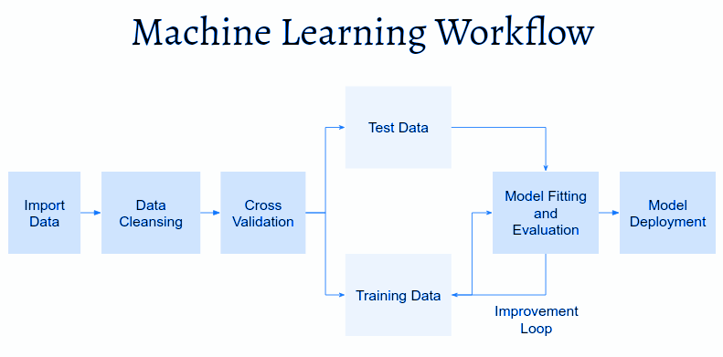
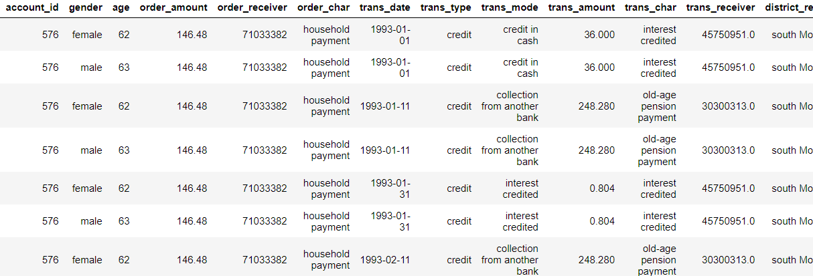

CH Banking Solutions – a Capstone Project for Fraud Detection Using Machine Learning
Caroline Teixeira de Sá, Heber Junio dos Anjos Mota / CCT College Dublin ( EdD Cohort 8) / May 2024
Abstract
Research Questions
Findings
Conclusion
The principal objective of the Banking Solutions initiative is to leverage machine learning methodologies to detect and address fraudulent transactions within a designated dataset. Our goal is to develop a robust system adept at managing financial data.
To lay the groundwork for our analysis, we meticulously prepared and encoded the dataset, employing SMOTE techniques to address data imbalances. Through these efforts, we anticipate the creation of a comprehensive and competitive Banking Solutions product.
1. How can machine learning enhance fraud detection in financial transactions?
Machine learning can improve fraud detection by optimizing algorithms and employing ensemble learning methods.
2. What data mining techniques best segment customers for targeted marketing?
Effective data mining techniques include clustering and association rule mining for customer segmentation.
3. How can data mining and machine learning be integrated to visualize insights for informed decision-making in banking?
Integration of data mining and machine learning enables visualization of insights and trends, adding informed decision-making in banking.
Add your information, graphs, and images to this section.
Add your information, graphs, and images to this section.
Introduction
The database, curated by Petr Berka and Marta Sochorova comprises financial data sourced from a Czech bank, encompassing details of over 5,300 bank clients and approximately 1,000,000 transactions. This research to delve into the intricate details encompassing resources, limitations, assumptions, and various other factors. By meticulously scrutinizing these components, we can gain a deeper comprehension of the project's scope and prerequisites, thus ensuring the development of a sturdy and efficient data analysis strategy.
In establishing goals for data mining and machine learning, it is imperative to align them with the aims of the project. These goals are designed to harness the capabilities of data mining and machine learning to visualize valuable insights, improve decision-making processes, and foster business expansion. By defining precise and measurable objectives, the project can concentrate on implementing effective solutions that hold tangible benefits and enhance organizational value.
Below, we can see a sample of our dataset:
Data Preparation & Modelling
1. Data Cleaning and Merging: Unnecessary columns will be dropped, and remaining features will be renamed for clarity and consistency. Cleaned datasets will be merged based on common columns.
2. Data Visualization: Features of interest will be visualized to explore their relationships within the dataset using EDA.
3. Data Preparation: Numeric features will be normalized using MinMaxScaler to ensure they are on a similar scale. Categorical columns will be transformed into binary sub-columns using One-Hot Encoding. Standardization techniques will be applied to further preprocess the data. Principal Component Analysis (PCA) will be utilized for dimensionality reduction.
4. Applying Models: Models such as Random Forest Regressor will be employed for detecting fraudulent transactions.
5. Model Deployment: Once deployed, the model will be ready to receive input data, make predictions, and provide valuable insights to end-users or other downstream systems.
Conceptual Framework
References
1. 1999 Czech Financial Dataset - Real Anonymized Transactions - dataset by lpetrocelli (2019) data.world. Available at: https://data.world/lpetrocelli/czech-financial-dataset-real-anonymized-transactions (Accessed: 12 March 2024).
2. https://webpages.charlotte.edu/mirsad/itcs6265/group1/index
.html (Accessed: 12 March 2024).
3. https://github.com/carolinedesat/capstone-pair-project (Accessed: 20 March 2024).
Source: https://data.world/lpetrocelli/czech-financial-dataset-real-anonymized-transactions
Source: https://rpubs.com/Argaadya/crispr_dm

